Slide 1
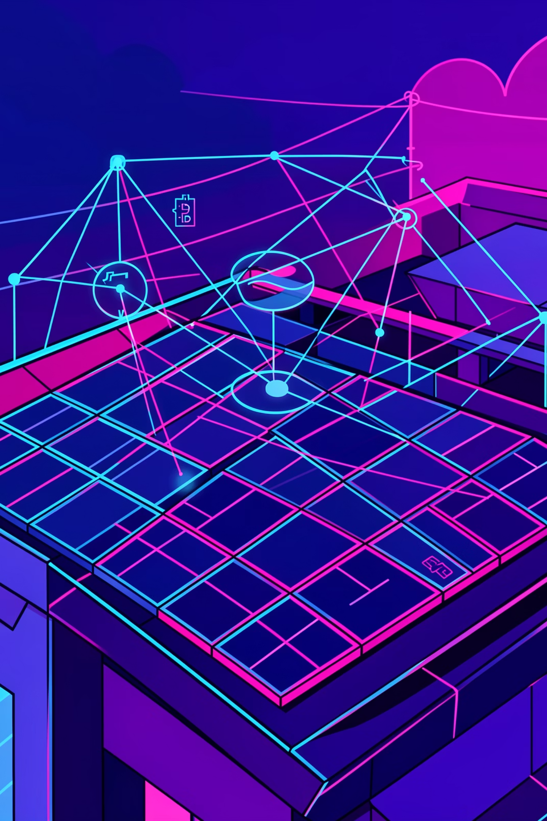
CreditMesh: Solar DePIN Protocol
Empowering community-owned energy grids through decentralized physical infrastructure on Creditcoin

Slide 2
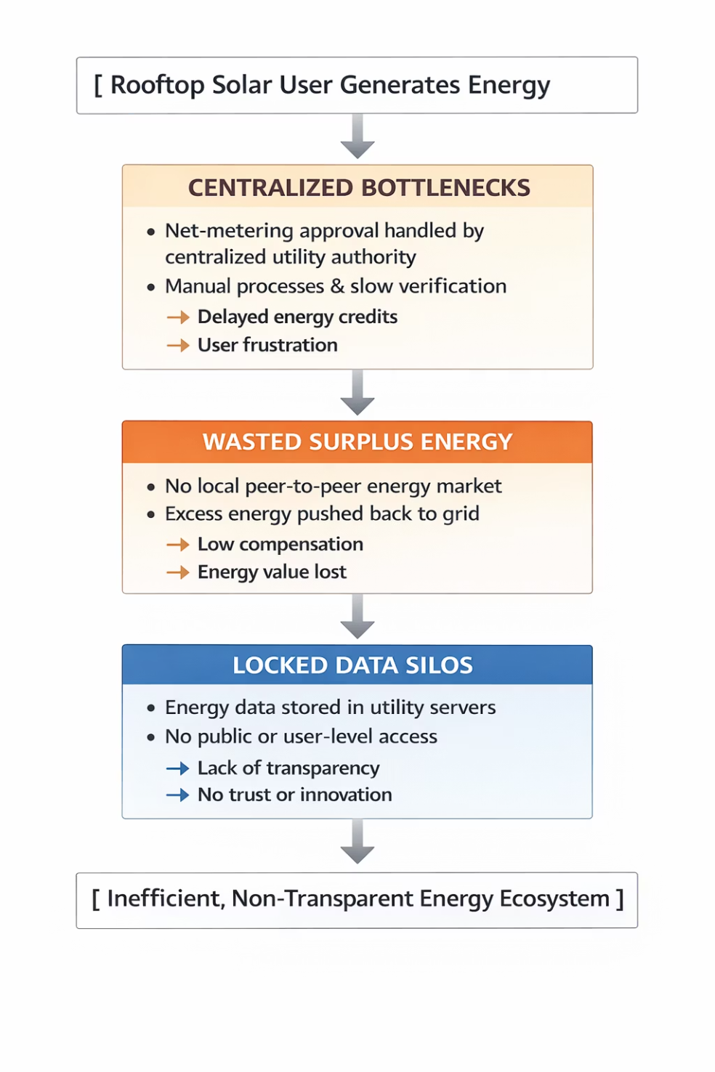
PROBLEM SPACE
The Coordination Gap in Solar Energy
Centralized Bottlenecks
Slow net-metering approvals delay energy credits and frustrate solar adopters
Wasted Surplus Energy
No infrastructure exists for local peer-to-peer energy sharing between neighbors
Locked Data Silos
Energy production data remains trapped within utility systems, preventing transparency

Slide 3

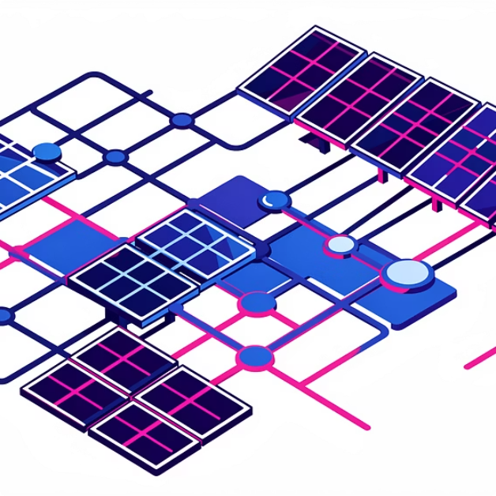
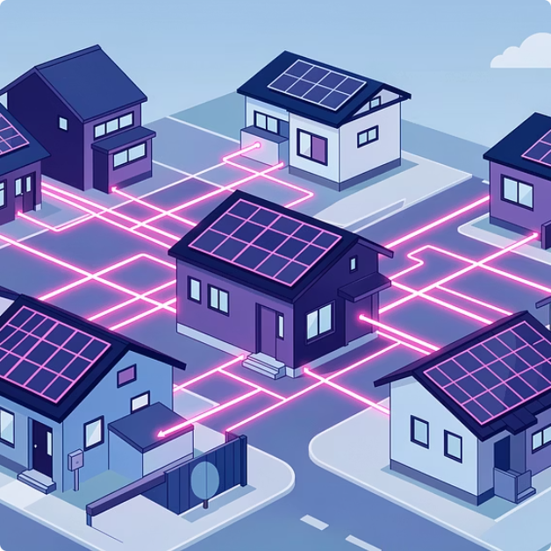
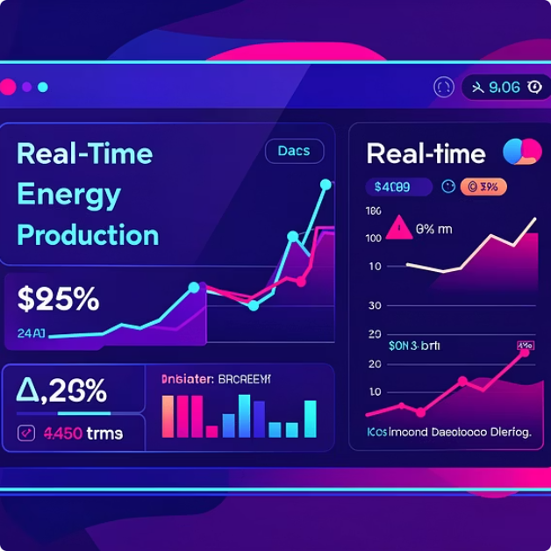
SOLUTION
CreditMesh: Decentralized Settlement Layer
Instant On-Chain Credits
P2P Energy Grid
Verifiable Truth
Automated settlements replace slow utility approvals with real-time blockchain verification
Solar nodes unite into a decentralized marketplace for local energy distribution
Tamper-proof, transparent energy logs accessible to all network participants

Slide 4
Why DePIN? Why Creditcoin?
Decentralized Physical Infrastructure
Built on Creditcoin
Blockchain's most powerful use case isn't just finance—it's coordinating real-world physical assets at scale. CreditMesh transforms solar panels into verified network nodes with provable output.
Creditcoin's infrastructure provides the settlement layer for instant, transparent energy credit distribution. The blockchain ensures every kilowatt-hour is accurately recorded and fairly compensated without intermediaries.

Slide 5
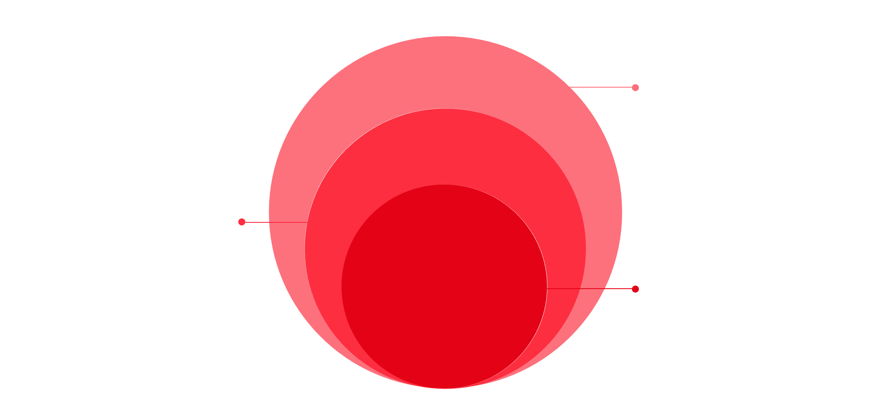
ARCHITECTURE
Hybrid DePIN System Design
Hardware Layer
Smart meters collecting solar data
Edge Aggregator
Off-chain validation preventing attacks
Settlement Layer
Creditcoin contracts and rewards
CreditMesh combines physical smart meters with blockchain verification to create a secure, scalable solar energy network with built-in fraud prevention.

Slide 6
Technical Implementation
Blockchain Layer
Backend Services
Hardware Simulation
User Interface
Creditcoin L1/L2 for settlement
Node.js/Express data aggregator
React.js dashboard
Python modeling of solar cycles
Real-time node owner analytics
Smart contracts in Solidity/Ink!
Off-chain validation engine
IoT smart meter data generation

Slide 7

EnergyVault Smart Contract
Core Contract Logic
Reward Formula
The EnergyVault.sol contract forms the backbone of CreditMesh, tracking cumulative contributions from each registered solar node.
Rewards = (Node Energy / Total Network Energy) × Reward Pool
Key Features:
Transparency: Any participant can audit node contributions on-chain
Node registration and identity verification
Energy contribution tracking per node ID
Automated reward calculation and distribution
Public audit trail for transparency
Efficiency: Batched submissions reduce gas fees by up to 80%
By batching data submissions, we minimize gas costs while maintaining cryptographic security and preventing data tampering.

Slide 8
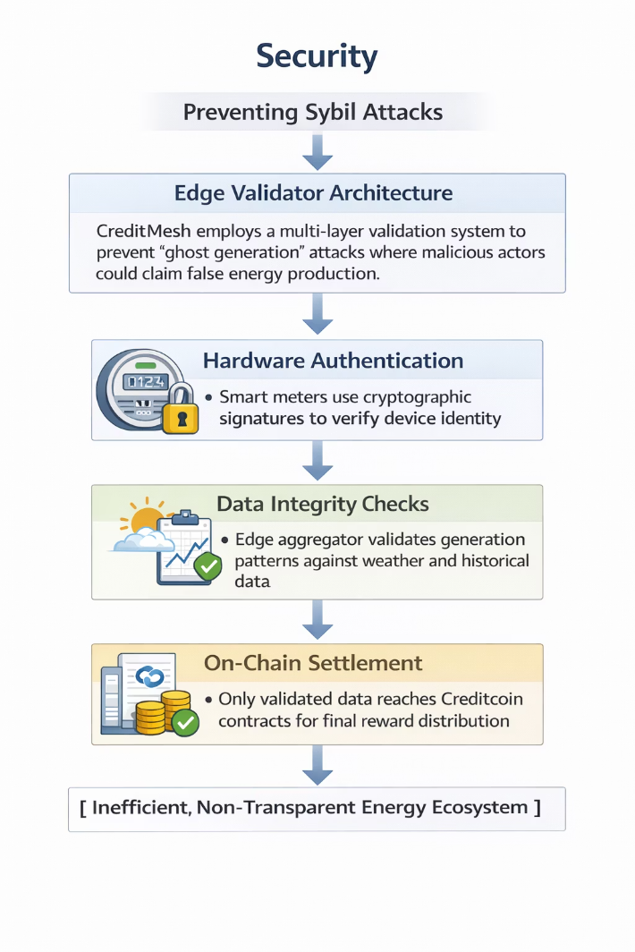
SECURITY
Preventing Sybil Attacks
Edge Validator Architecture
CreditMesh employs a multi-layer validation system to prevent "ghost generation" attacks where malicious actors could claim false energy production.
01
02
Hardware Authentication
Data Integrity Checks
Smart meters use cryptographic signatures to verify device identity
Edge aggregator validates generation patterns against weather and historical data
03
On-Chain Settlement
Only validated data reaches Creditcoin contracts for final reward distribution

Slide 9
Development Roadmap
1
Phase 1: Smart Contract Foundation
Prototype contracts for node registration, energy tracking, and basic reward distribution mechanisms
2
Phase 2: Edge Validation Layer
Build off-chain validator to prevent data tampering and sybil attacks with cryptographic verification
3
Phase 3: Demand Integration
Connect with EV charging APIs to enable local energy consumption and true peer-to-peer markets
4
Phase 4: Physical Pilot
Deploy 10 DIY smart meters in real homes to validate end-to-end system performance

Slide 10
Join the Energy Revolution
Moving Beyond Centralized Energy
Get Started
CreditMesh proves that blockchain technology can coordinate real-world infrastructure more efficiently than traditional systems. By transforming solar panels into verified network nodes, we're building the foundation for community-owned energy grids.
Repository: github.com/creditmesh-depin
Built with Creditcoin blockchain infrastructure
Why This Matters:
India's rooftop solar sector faces massive coordination challenges. CreditMesh solves this with transparent, automated settlements that empower communities to take control of their energy future.
DePIN × Solar × Community

